Slide 1
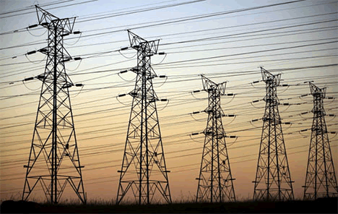
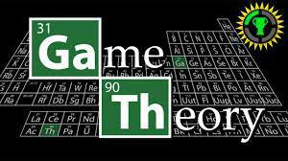
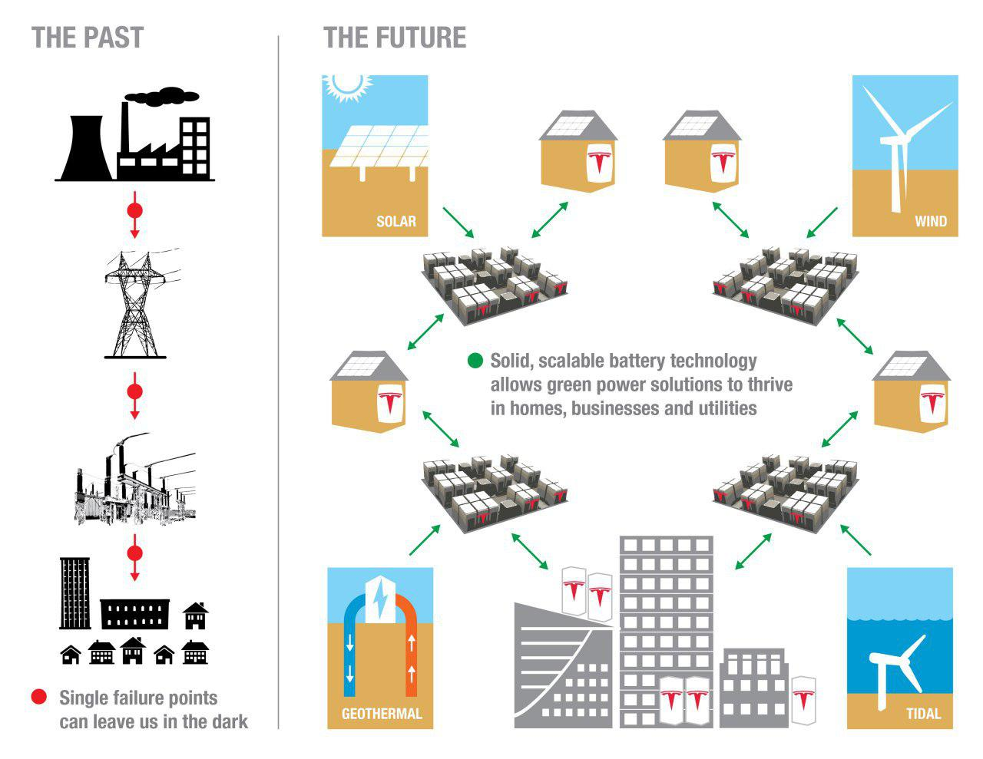

Game Theory for Energy Trading in Smart Grid
Instructor: Dr. Afsharchi
Present by Zanyar Sharifi
April 18 ,2017

Slide 2
Outline
Introduction
Problem
Simulation Results And Analysis of algorithm

Slide 3

What is a Smart Grid?

Slide 4
Problem
Analysis of the energy trading between the storage unites and the various smart grid elements.
Game theory rule is to Control individual sources/load
Develop a new framework for solving those challenges based on Game theory

Slide 5
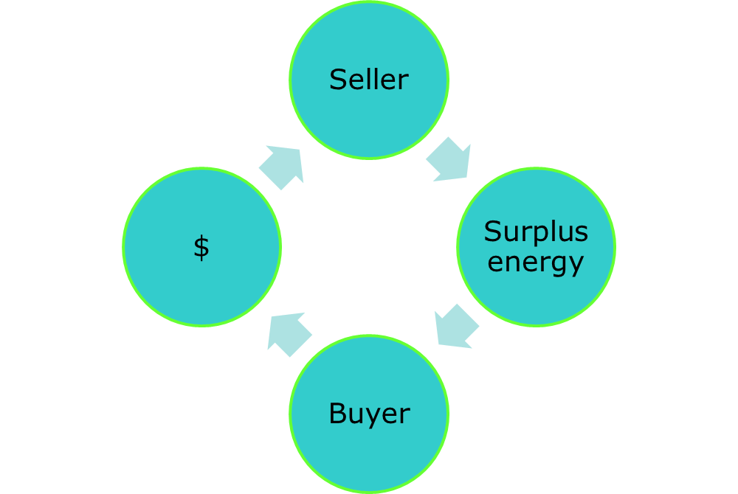
Problem

Slide 6
Problem
Used Game theory for :
Managing of correct decision making in auction model
increasing Utility of sellers
Finding NE for cost of energy

Slide 7
Develop an new framework
Design a double-action model for cooperate multi sellers and buyers
Combine a double auction model with noncooperative game
Develop a new algorithm to guaranty to reach equilibrium with two level of interaction

Slide 8
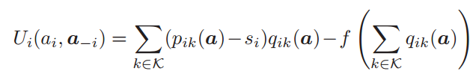
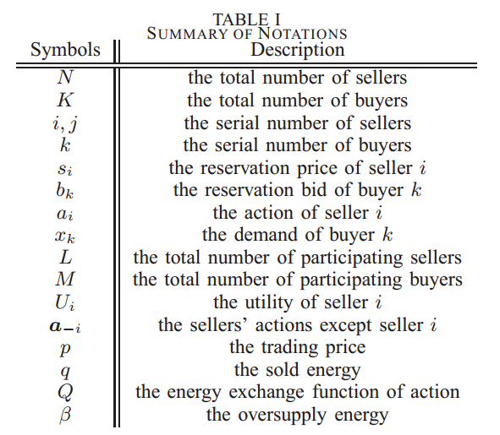
Utility function

Slide 9
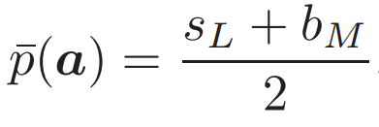
Supply and demand
unite price

Slide 10
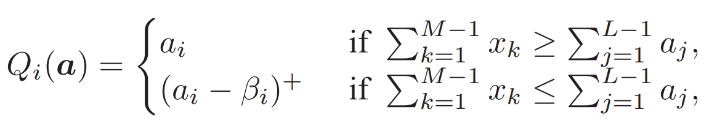
Final utility function

Slide 11
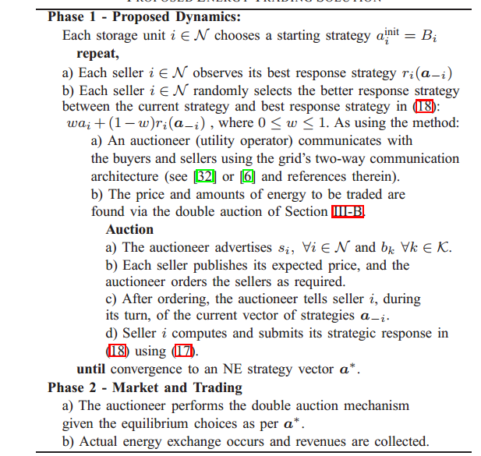
Proposed energy trading solution

Slide 12
Thanks

Slide 13
Any Question ?

